Slide 1

Complex Sampling Design Methods An overview and actual study
Rashmi Kalra

Slide 2
Outline
Introduction to Sampling
Sampling strategies
What is complex sample
Types of Complex Sample
Complex Sampling design example from actual Study

Slide 3



Introduction to sampling
Population : Group of things that we want information about
Sample: Part of the population that we take out to examine to estimate the population attributes.

Slide 4
Key Concepts in sampling
Theoretical Population
Target Population: Collection of all the elements about which we want to make to make inference.
Sampling Population
Sampling Frame
Study Population
Sample
Element : Object on which the measurement is taken

Slide 5
Types of sampling
Sampling
Non-Probability Sampling
Probability Sampling

Slide 6
Non-Probability sampling
Sampling
Non-Probability Sampling
Probability Sampling
Non-Probability Samples: A type of sampling where it is not known which of the units will be picked to be sampled, and where some of the units have a zero probability of being chosen.
It is Biased Sampling technique (occurs when one or more part of the population is favored over the others)
Convenience Sample
Voluntary Response Sample

Slide 7
Non-Probability sampling
Sampling
Non-Probability Sampling
Probability Sampling
Convenience Sample: Only include people who are easy to reach. This is Biased sample because not everyone has the equal chance of being part of the sample.

Slide 8
Non-Probability sampling
Sampling
Non-Probability Sampling
Probability Sampling
Voluntary Response Sample/ Quota Sample (Mall Intercept Studies): It consist of people that have chosen to include themselves. (This is Biased sample because people with the strong opinion are going to respond)
We would like to take part in the survey .
On the scale from 1 to 10 how do you feel about magazine A?

Slide 9
Probability sampling
Sampling
Non-Probability Sampling
Probability Sampling
Probability Sample is the sampling in which every unit in the population has (chance greater than zero) of being selected and probability can be accurately determined.
Simple Random Sample
Stratified Sample
Cluster Sample
Multistage
Systematic Sample

Slide 10
Simple Random Sample
Simple Random Sample: In a simple random sample, individual sampling units are selected at random with equal probability and without replacement (WOR) directly from the entire population.
We could take Simple Random Sample of six patients from the Sampling frame.

Slide 11
Why is a complex sampling needed?
Probability samples that don’t meet the assumptions of Simple Random Samples are called Complex Samples . The “complex sampling” that gives rise to these survey data sets often has three key features:
1) Stratification of a target population of interest into different divisions of the population that are homogeneous within and heterogeneous between in terms of the measures of interest;
2) Multi-stage sampling of clusters of population elements, which are generally either geographic areas to save costs
3) Unequal probability of selection into the sample for different population elements of interest, including differential probability of response to the survey for different population subgroups, which gives rise to a need to use weights when computing finite population estimates
It is not always possible to use Simple random sampling in most cases because:
1) Not all sampling units of target population may be accessible and if widespread then expensive to access.
2) If some members of the population (e.g., of a particular demographic background) are relatively low in number, a simple random sample might not obtain enough (or any) of these individuals.

Slide 12
Stratified Random Sample| Complex Sample
Stratified sampling involves splitting the population into subgroups (“strata”) before sampling, and then applying sampling (usually SRS) separately within each and every group (“stratum”).
Strata be formed based on common characteristic(s) of the items to be put in each stratum. This means that elements should be homogeneous within each stratum . Precision of estimates is expected to be greater when members within the strata are Homogeneous as compared to between strata.
Stratified sampling can help to ensure that the sample collected is representative of the population, by guaranteeing that sufficient individuals from each sub-group (e.g., gender, or socioeconomic status) will be sampled.
Independent Random Sample are then selected from each of the identified strata. Selection approach can differ across the strata but if we are taking the SRS from each strata that sampling technique is known as Stratified Random Sampling.

Slide 13
Stratified Random Sample | Complex Sample
Study Goal: Predict the average income of population and ages are known in advance
People with different age groups grouped together in different strata for accurate income estimation
Stratified Sampling
Looking at our initial population set again
Age 18-24
Age 25-35
Age 36-45
Age 46-55
Age 55-65
Age 65+

Slide 14
Cluster Sampling | Complex Sample Design
Cluster sampling involves the selection of groups of sampling units, or clusters . For example, clusters may be schools, hospitals, or geographical areas, and sampling units may be students, patients, or citizens. Clustering is common in multistage designs and area (geographic) samples.
Construction of clusters: The clusters are constructed such that the sampling units are heterogeneous within the clusters . Each cluster should contain the full diversity of the population and thus, is 'representative'.
Multiple clusters with each cluster representative of whole population
Select all from cluster or
SRS from clusters
Notes:
If the total area of interest happens to be a big one, a convenient way in which a sample can be taken is to divide the area into a number of smaller non-overlapping areas and then to randomly select a number of these smaller areas (usually called clusters), with the ultimate sample consisting of all (or samples of) units in these small areas or clusters.

Slide 15


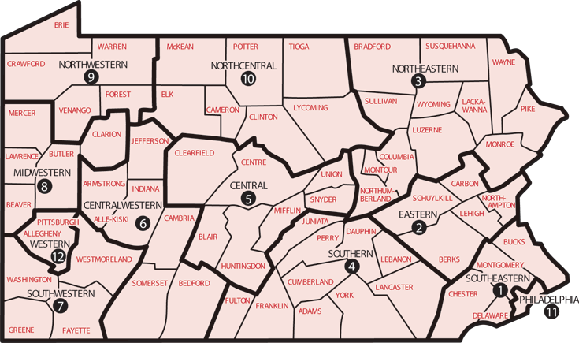

Multistage Sampling | Complex Sample Design
Multi-stage sampling is a further development of the principle of cluster sampling. Sample selection can occur in one or two stages (or more)
One Stage : Selecting the cluster then involving everybody within that cluster (cluster=Primary Sampling Units)
Two stage: Selecting the cluster(PSU) then selecting sample of individual units inside the cluster(individual units=Secondary Sampling Units) .
Suppose we want to know the math performance of all high school students in Pennsylvania
Stage 1: Schools are clustered in counties and a small sample of counties are randomly selected
PSU: Counties
Stage 2: Within each selected county, school districts are randomly selected from previously selected counties
SSU: School District
Stage 3: High school math classes are randomly selected from previously selected school districts
TSU: Classrooms
A 4th stage can also be created where students are randomly selected from previously selected classes
At all stages, we can create stratification if required to make our study more targeted and inclusive

Slide 16
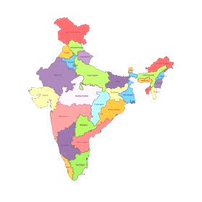
Complex Sampling in Actual Study
Goal of the Survey: Pew Research center wanted to study the religious beliefs and practices as well as the diversity across all the India. Goal to include all the six major religions (Hindu, Muslim, Sikh, Christians,Buddhists and Jains)
28 States
8 Union Territories
Sample:
Total sample included 30,000 adults across the country (22,975 Hindus, 3,336 Muslims, 1,782 Sikhs, 1,011 Christians, 719 Buddhists and 109 Jains)
Covered 33 different states and union territories
Conducted survey in 17 different languages

Slide 17
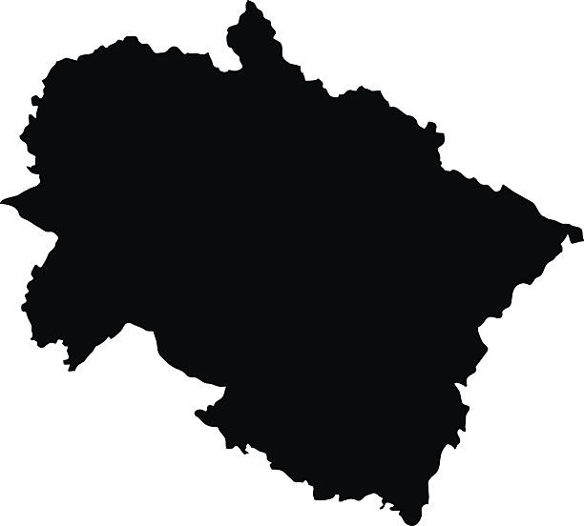
Complex Sampling in Actual Study
Sampling Design - Sampling was conducted through a probability-based, stratified multistage clustered random design.
Step1: Creating States as Stratas
Total 33 states and union territories
Smallest groups collapsed together
A total of 30 strata were created
30 strata were created

Slide 18
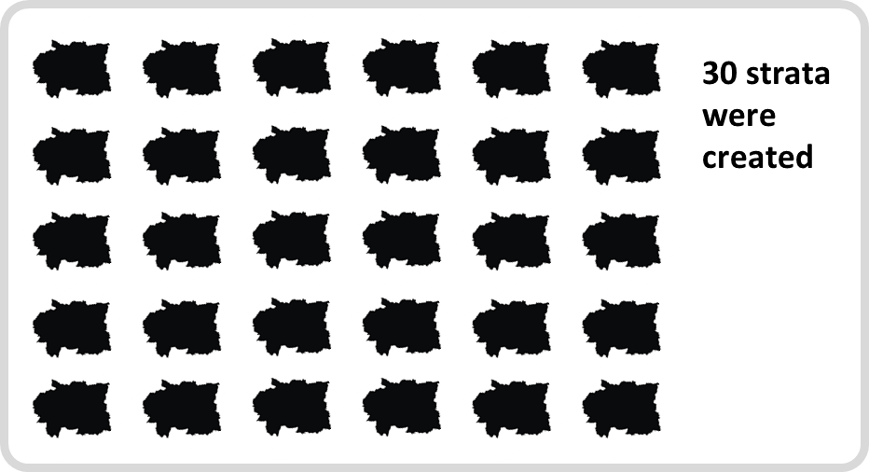


Complex Sampling in Actual Study
Step2: Multistage Cluster Random Sampling is performed for each stratum.
6 Sub -districts created from each district
Random Selection
Random Selection
133 Districts created
Primary Sampling Units
Secondary Sampling Units
4 villages/block created from each sub-district
Composite Measure of Size(cMOS)
12 households from blocks
Random Selection
Random Selection
Randomly selected Individuals with age 18 and older living in the household.
Tertiary Sampling Units
Weighting
Probability Proportional to size(PPS)

Slide 19
Complex Sampling in Actual Study
Composite Measure of Size (cMOS ) at PSU and SSU level
Hindu Muslim Sikh Christians Jains Buddhists
If the sample had been selected using a typical approach (e.g., probability proportional to population size), they would not have enough respondents from some religious groups( lower prevalence in country). Used CMOS for sampling PSUs and SSUs giving areas with low-incidence religious populations (Muslims, Christians, Sikhs, Buddhists or Jains) having greater chances of selection.
Example: Mansahi has a greater chance using our cMOS, since Mansahi is home to a large share of a lower-incidence religious group.
Minority religion overall and PSU/SSU with higher Proportion are assigned more values to improve their chance of selection
Low prevalence

Slide 20
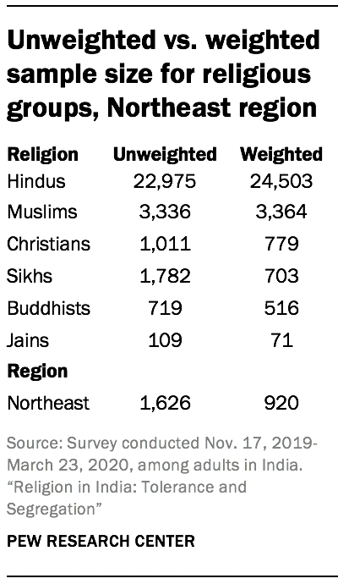
Complex Sampling in Actual Study
Sample Weighting
Sample weighting is the inverse of selection probability.
Sample weighting was done to make the sample like the actual population census figures. Weighting calibration process was conducted for age by gender, education and urbanicity separately for each of the strata.
Weights are adjusted in poststratification process. The weights for each stratum are then scaled to correct for the oversampling of some regions and states and the corresponding under sampling of larger regions and states. This ensures that all states and subsequent regions are represented in their proper proportion in the weighted estimates included in this report.

Slide 21
References
https://www.pewforum.org/2022/03/02/methodology-47/
https://www.pewforum.org/2021/06/29/religion-in-india-tolerance-and-segregation/

